Slide 1
SITES DRUG BIOTRANSFORMATION
of
HEPATIC METABOLISM
List of DRUGS
undergo
First-pass effect
SULFASALAZINE
Process
Reductive Reaction
Absorption Site
Intestine & Colon

Slide 2
SITES DRUG BIOTRANSFORMATION
General Pathway of Drug Metabolism
of
HEPATIC METABOLISM
List of DRUGS
undergo
First-pass effect
Isoproterenol
Process
Sulfate Conjugation
Absorption Site
Gastrointestinal Tract

Slide 3
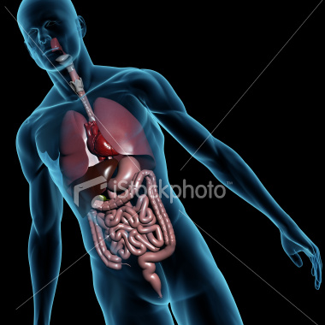
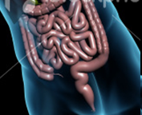
SITES DRUG BIOTRANSFORMATION
General Pathway of Drug Metabolism
of
enzyme
ß-glucuronidase
FREE DRUG
Glucuronide conjugates
HYDROLYZE =
reabsorption
ENTEROHEPATIC CIRCULATION
also known as
RECYCLING

Slide 4
THE ROLE CYTOCHROME P-450MONOOXYGENASE
General Pathway of Drug Metabolism
of
Oxidative Biotransformation
General Equation describing the oxidation of many xenobiotics (R-H) forming a metabolite (R-OH)
R-H+NADPH+O₂+H⁺
R-OH +NADPH+H₂O
substrate
Reducing
agent
Molecular
O₂
MONOOXYGENASE Mixed-function oxidase

Slide 5
THE ROLE CYTOCHROME P-450MONOOXYGENASE
General Pathway of Drug Metabolism
of
Oxidative Biotransformation
CYP
CYP3A4
1,2,3
A,b
2,9
system
Capital Letter
Arabic Number
family
Capital Letter
subfamily
Arabic Number
enzyme

Slide 6
THE ROLE CYTOCHROME P-450MONOOXYGENASE
General Pathway of Drug Metabolism
of
CYP-450
Oxidative Biotransformation
Made-up of several components
NADPH dependent cytochrome P450 reductase
NADPH linked cytochrome B₅
Supply the electrons needed in overall metabolic oxidation of xenobiotics
Called the superfamily of Cytochrome
Most important enzyme composed of 57 genes
Responsible for the transfer of O₂ to the substrate R-H

Slide 7
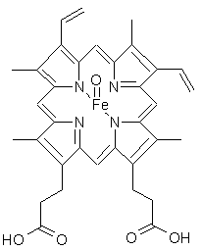
THE ROLE CYTOCHROME P-450MONOOXYGENASE
General Pathway of Drug Metabolism
of
CYP-450
Oxidative Biotransformation
Heme-proteins that contains iron
Heme portion - protoporphyrinIX
Protein portion – apoprotein
Iron portion - reducing iron
In this form, it binds to CO to form a complex that have a maximum absorption of 450nm ²⁸

Slide 8
THE ROLE CYTOCHROME P-450MONOOXYGENASE
General Pathway of Drug Metabolism
of
CYP-450
Oxidative Biotransformation
Important features:
Plays a vital role in oxidation of
lipophilic xenobiotics
metabolize almost unlimited number
of diverse substrates by a variety of
oxidative transformations.
-abundantly located in the liver’s endoplasmic reticulum

Slide 9
THE ROLE CYTOCHROME P-450MONOOXYGENASE
General Pathway of Drug Metabolism
of
CYP-450
Oxidative Biotransformation
Important features:
- When liver tissues HOMOGENIZE, the ER loses its structure & converted to small vesicular bodies known as microsomes
also found in Mitochondria where it will biosynthesize the steroidal hormones & metabolize vitamins

Slide 10
THE ROLE CYTOCHROME P-450MONOOXYGENASE
General Pathway of Drug Metabolism
of
CYP-450
Oxidative Biotransformation
In a form Cytochrome P-48, it can be induced to:
Phenobarbital
Benzol alpha-pyrene
3-methylcholanthrene

Slide 11
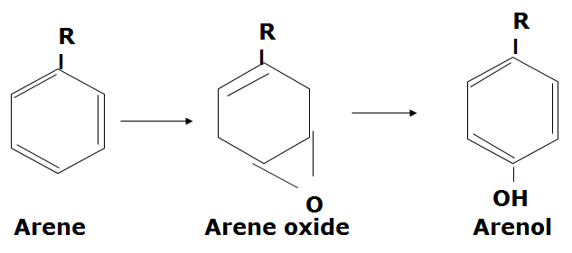
Oxidative reactions
General Pathway of Drug Metabolism
Oxidation of Aromatic moieties
-refers to the mixed-function oxidation of aromatic ompounds (arenes) to their corresponding phenolic
metabolites (arenols).

Slide 12
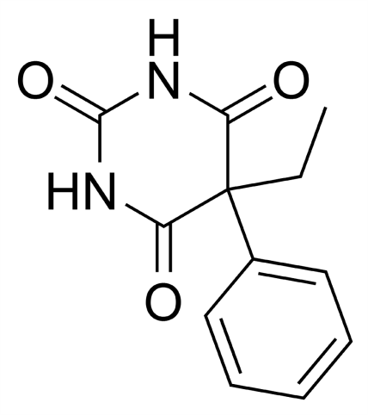
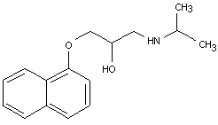
Oxidative reactions
General Pathway of Drug Metabolism
Oxidation of Aromatic moieties
AROMATIC HYDROXYLATION
major route of metabolism for many drugs containing PHENOL groups such as
Phenobarbital
Propranolol

Slide 13
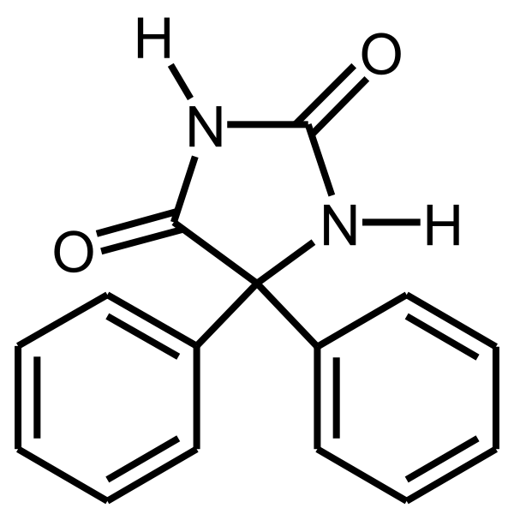
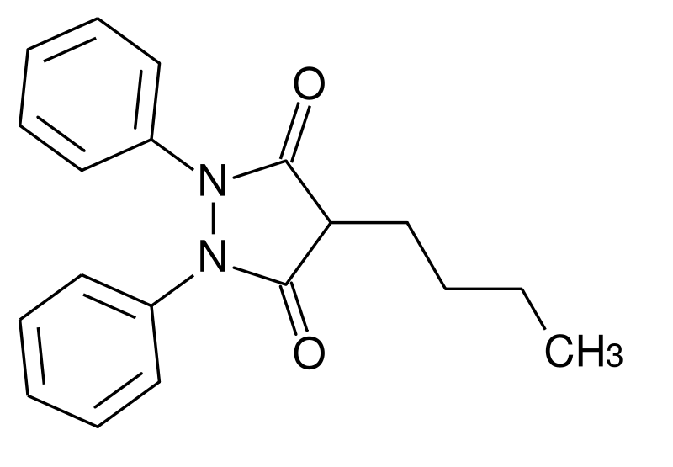
Oxidative reactions
General Pathway of Drug Metabolism
Oxidation of Aromatic moieties
AROMATIC HYDROXYLATION
major route of metabolism for many drugs containing PHENOL groups such as
Phenylbutazone
Phenytoin
Metabolite: oxyphenbutazone
Metabolite: O-glucuronide
Anti-inflammatory

Slide 14
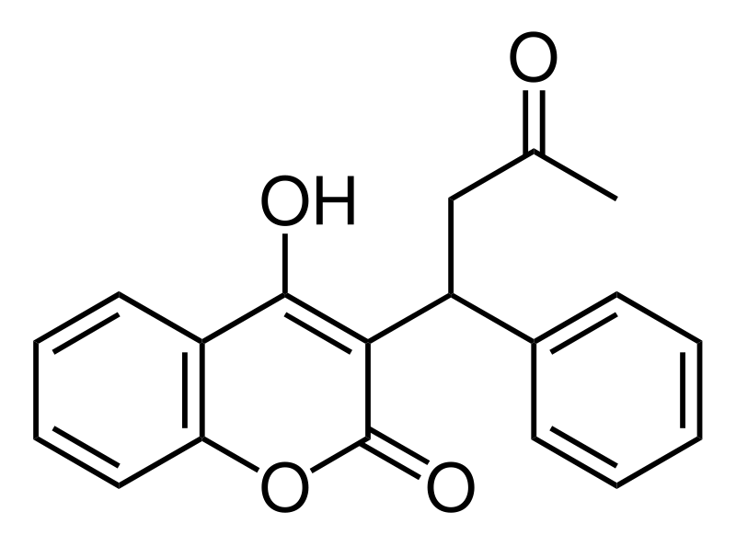
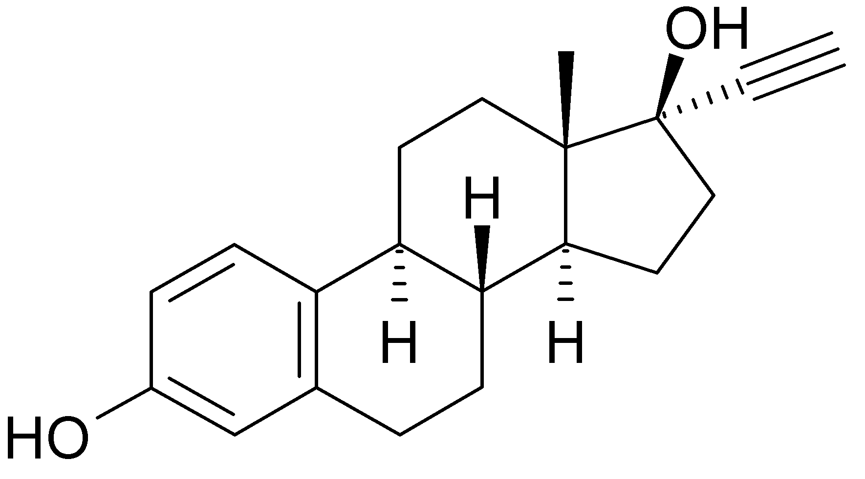
Oxidative reactions
General Pathway of Drug Metabolism
Oxidation of Aromatic moieties
AROMATIC HYDROXYLATION
major route of metabolism for many drugs containing PHENOL groups such as
Ethinylestradiol
Warfarin
Metabolite: 7-hydroxywarfarin
Anti-coagulant

Slide 15
Oxidative reactions
General Pathway of Drug Metabolism
Oxidation of Aromatic moieties
AROMATIC HYDROXYLATION
occur at the PARA position
Phenolic metabolites undergo further conversion to become polar and water-soluble Glucuronide or Sulfate conjugates

Slide 16
Oxidative reactions
General Pathway of Drug Metabolism
Oxidation of Aromatic moieties
AROMATIC HYDROXYLATION
Deactivating groups generally slow or resist aromatic hydroxylation includes:
Chloro (Cl)
Amino group(NR₃)
COOH
NH-R
SO₂

Slide 17
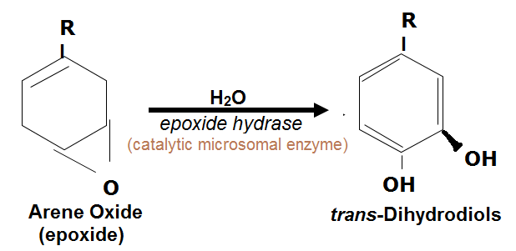
Oxidative reactions
General Pathway of Drug Metabolism
Oxidation of Aromatic moieties
Two Important reactions in neutralizing arene oxides reactivity
HYDRATION
Nucleophilic attack of water on the epoxide

Slide 18
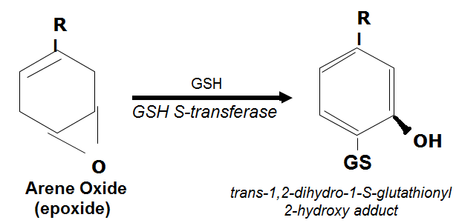
Oxidative reactions
General Pathway of Drug Metabolism
Oxidation of Aromatic moieties
Two Important reactions in neutralizing arene oxides reactivity
NUCLEOPHILIC RING OPENING
By the Sulfhydryl group

Slide 19
Oxidative reactions
General Pathway of Drug Metabolism
Oxidation of Olefins
Reaction leads to the formation of epoxide or oxirane
Susceptible to ENZYMATIC HYDRATION & GSH CONJUGATION

Slide 20
Oxidative reactions
General Pathway of Drug Metabolism
Oxidation of Olefins
Reaction leads to the formation of epoxide or oxirane
Toxicity of olefinic compounds is due to the metabolic conversion to reactive epoxide

Slide 21
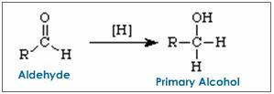
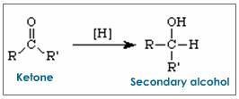
Oxidative reactions
General Pathway of Drug Metabolism
Oxidation at Benzylic Carbon Atoms
Carbon atoms attached to the benzylic position are susceptible to oxidation forming an alcohol metabolite
Alcohol
Aldehyde
Carboxylic Acid

Slide 22
Oxidative reactions
General Pathway of Drug Metabolism
Oxidation at Benzylic Carbon Atoms
Carbon atoms attached to the benzylic position are susceptible to oxidation forming an alcohol metabolite

Slide 23
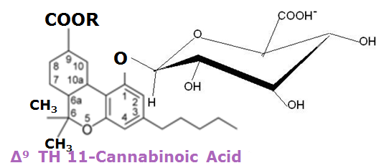
Oxidative reactions
General Pathway of Drug Metabolism
Oxidation at Allylic Carbon Atoms
CH₃
Marijuana (Δ¹ tetra Hydrocannabinol)

Slide 24
Oxidative reactions
General Pathway of Drug Metabolism
Oxidation at Allylic Carbon Atoms

Slide 25
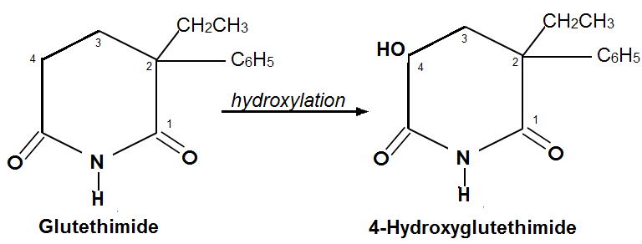
Oxidative reactions
General Pathway of Drug Metabolism
Oxidation at Carbon Atoms  to Carbonyls & Imines
Oxidizes Carbon atoms adjacent to Carbonyl (C=N) & Imino functionalities

Slide 26
…to be continued next meeting. Please prepare for a short quiz…
Good Luck!

